Slide 2
KubeEdge
Introduction

Slide 3


Cindy Xing Futurewei @cindyxing
Dejan Bosanac Red Hat @dejanb

Slide 4
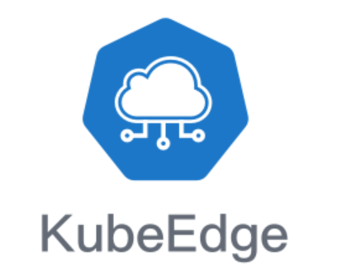
Quick Survey
How many of you first time heard about KubeEdge
How many of you know KubeEdge already
How many of you had run and used KubeEdge
How many of you cloned and built KubeEdge
How many of you like KubeEdge ☺☺☺

Slide 5
Challenges for IOT/Edge Computing
Benefits with Edge computing. However there are challenges
Network unreliable and with limited bandwidth
Fleet of edge nodes and devices
Heterogeneous hardware and protocols at edge
Resource constraint at Edge
Maintenance cost
Data locality and security

Slide 6

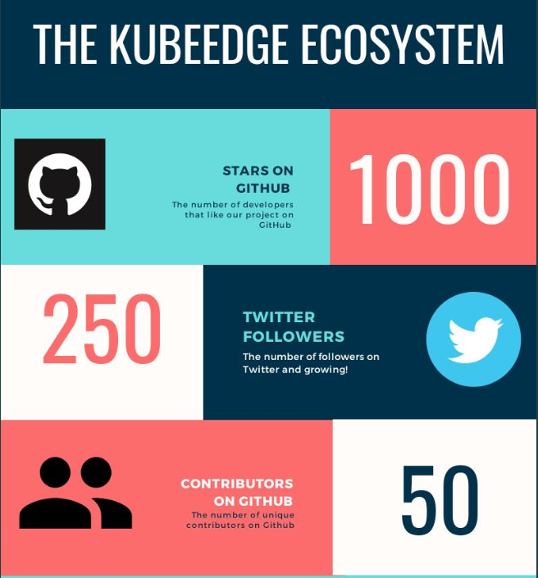
Background
KubeEdge targets to edge computing
CNCF Sandbox project
Open-sourced both cloud and edge code
Release 0.1, 0.2 and 0.3
Reference architecture by K8s IOT/Edge WG
K8S IOT/Edge WG

Slide 7
Our vision and mission
Enable customers to manage resources and run applications natively at cloud and edge
A K8s based infrastructure for IOT/Edge computing.
Manage resources and orchestrate applications in transparent of the location: cloud or edge
K8s APIs and primitive types
Edge is an extension of cloud
Worker nodes can be at cloud or edge
Highly extensible covering diversified network topology, device protocol, storage backend, etc.

Slide 8
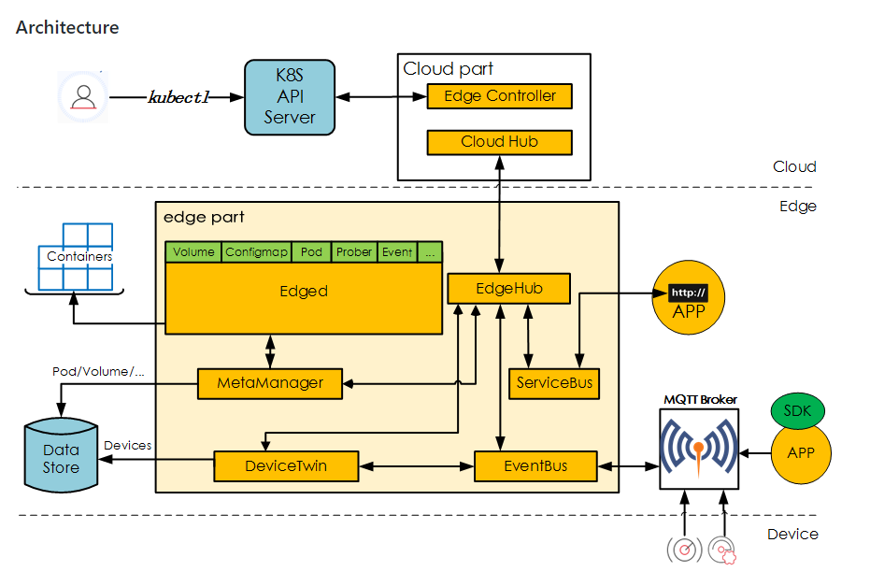
What’s New
Both cloud and edge code are open-sourced
Fundamental infrastructure support
Device management and messaging
MQTT, Zigbee, Bluetooth, etc device protocol wrapping support
Edge side autonomy covering network disconnect/reconnect scenario

Slide 9
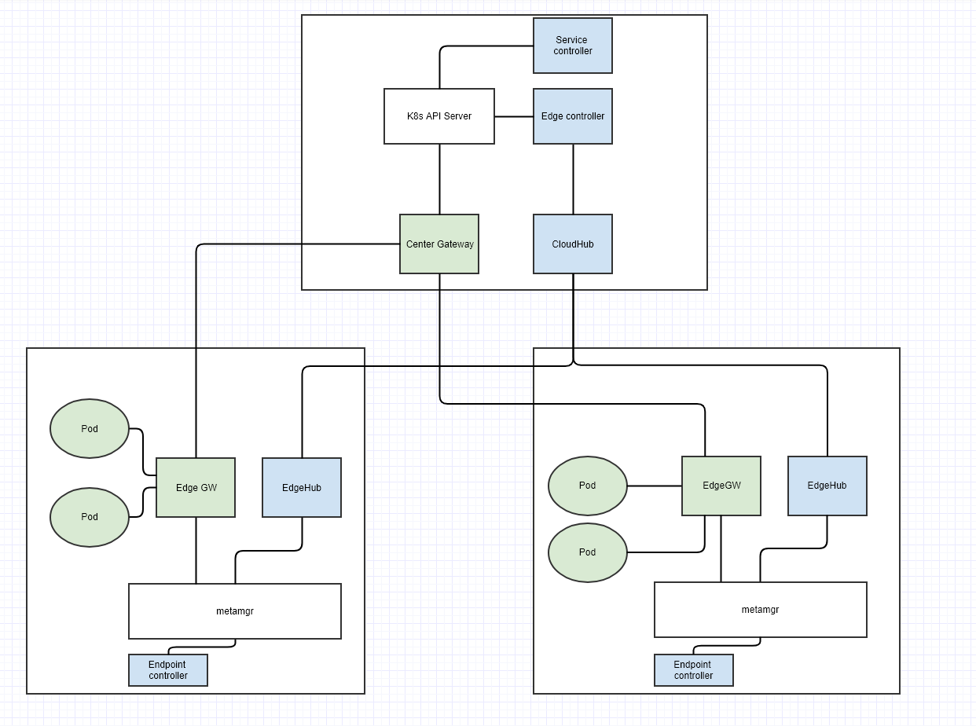
What’s Next --- Service Mesh
K8s service discovery, routing and lifetime management
Support service and endpoint
Service discovery
Support north-south and east-west network routing
Mesh for services at edge and cloud

Slide 10
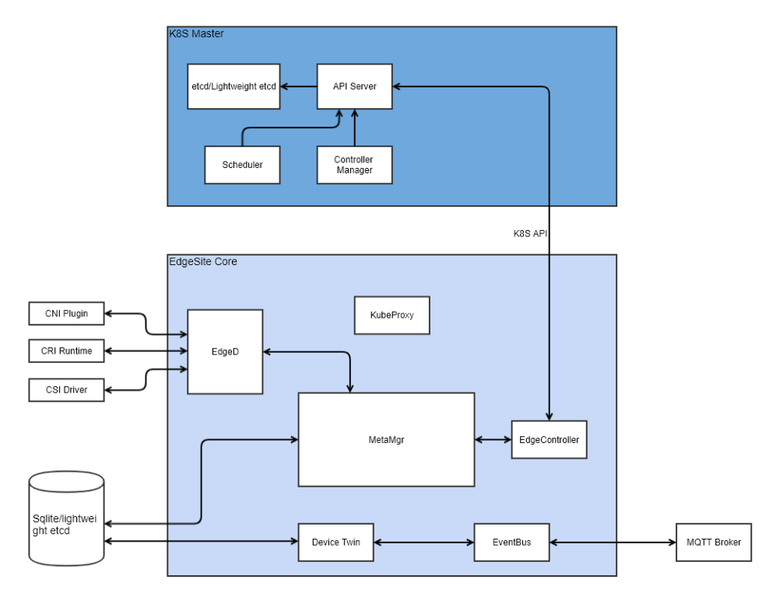
What’s Next --- EdgeSite
Enable customer to run a lightweight K8s cluster at edge where control plan can support HA
The KubeEdge pluggable module framework
Conformed K8s APIs

Slide 11
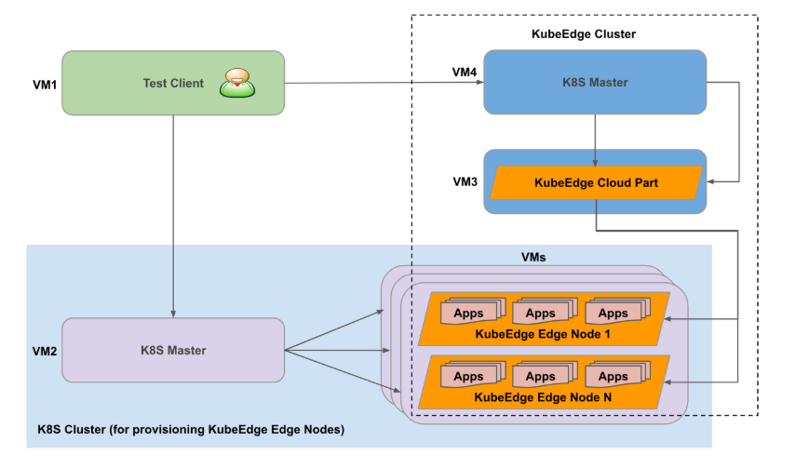
What’s Next --- Perf and Scale Evaluation
Evaluate the latency and throughput between edge and cloud
Scalability
How many edge nodes can a cluster support
How many pods can run on an edge node. E.g. Raspberry-pi

Slide 12
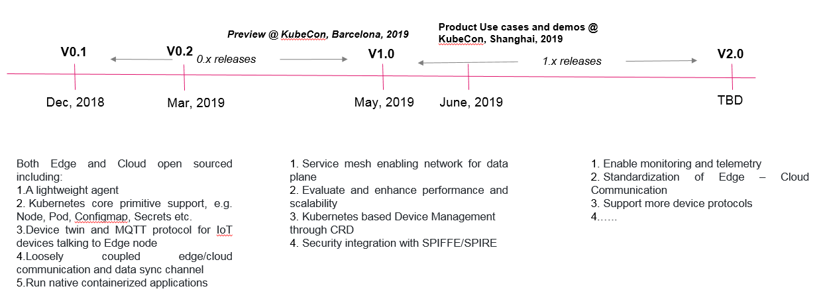
Roadmap

Slide 13
KubeEdge in the community
K8s IOT/Edge workgroup
Better integration with existing open source IoT platforms
Eclipse Hono – connectivity
Eclipse Ditto – digital twin
Collaboration with other open source Edge efforts
Eclipse ioFog
Collaboration with other working groups
Akraino
LF Edge

Slide 14
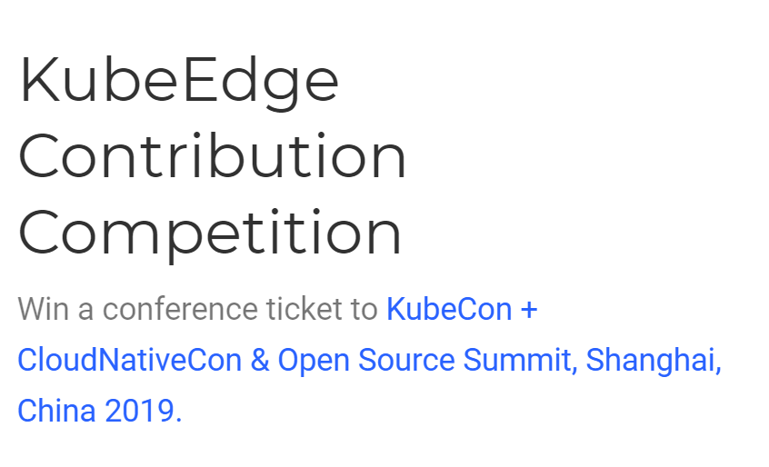
How to Find Us
Our site: https://kubeedge.io
Github: https://github.com/kubeedge/kubeedge
Slack channel: https://kubeedge.slack.com
Mailing group: https://groups.google.com/forum/#!forum/kubeedge
Bi-weekly community meeting: calendar
Twitter: https://twitter.com/KubeEdge
Documentation: https://docs.kubeedge.io/en/latest/

